Slide 1

Marketing Operations
Review of 2023
Kristen Powell
13th December 2023

Slide 2
Agenda
Welcome
Review of 2023
Open Q&A/Discussion

Slide 3

Marketing Operations Open Office Hours
Get your questions answered by the marketing operations team. Open Office Hours are held monthly with the following agenda:
  Learn about a tip or best practice
  Ask a question – Pre-submit your questions here or ask during the office hours
  Learn how to leverage IQVIA’s marketing systems and processes most effectively
Action: Sign up here, if you need to be added to the outlook invite
Reminder: Save your questions for the end or enter in the chat. We will address as many as we can!

Slide 4
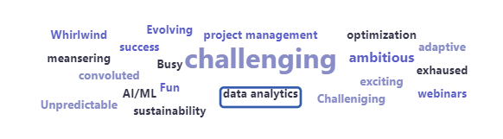
Let’s create a word cloud to celebrate our achievements and challenges!
What 3 words best capture your marketing journey in 2023?
(word cloud)

Slide 5
Which criteria best defines an IQVIA MQL?
IQVIA.com webpage viewer
Downloader
Hand raiser
Email Clicker
LinkedIn Post Liker

Slide 6
A Marketing Qualified Lead must be
Rejected by sales
Accepted by sales
Marked as marketing to nurture
Converted to an SQL

Slide 7
What is the name of the field used to link MQLs to Opportunities?
Related to
Opportunity
Primary Campaign Source
Campaign Name

Slide 8
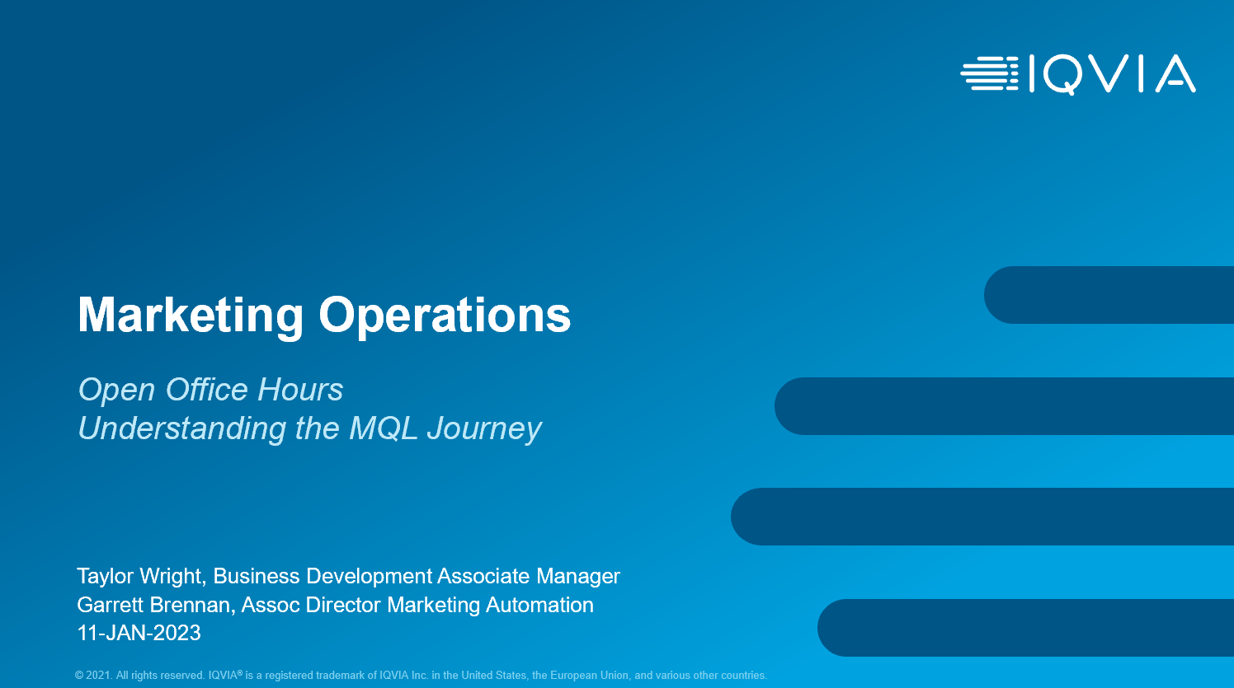

Understanding the MQL Journey
MQL definition
A prospect/customer identified by marketing that fits a defined profile and level of engagement agreed to by both marketing and sales and is ready to be turned over for sales activity. Most importantly, the prospect/customer is accepted by sales for further qualification. We focus on hand-raisers. If a prospect/customer is a “hand-raiser” they have explicitly asked up to follow-up on a specific business need and/or indicated an upcoming RFP
Header
MQL generating campaigns
Webinar/Event, MQL Form Submits, External Activity File Uploads
Inside sales follow-up process
Triage - > Outreach - > Opportunity Creation
Linking opportunities to MQLs
Ensure “Related To” field has opp name on the MQL Task

Slide 9
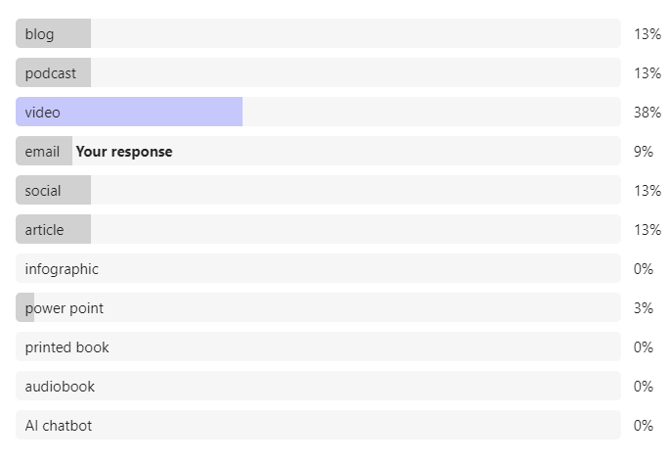
What is your favorite way to consume content?
blog
podcast
video
email
social
article
infographic
power point
printed book
audiobook
AI chatbot

Slide 10
How many IQVIA personas are there?
31
42
53
60

Slide 11
What criteria can you segment on and target?
Gender
Favorite Color
Age
Job Level

Slide 12
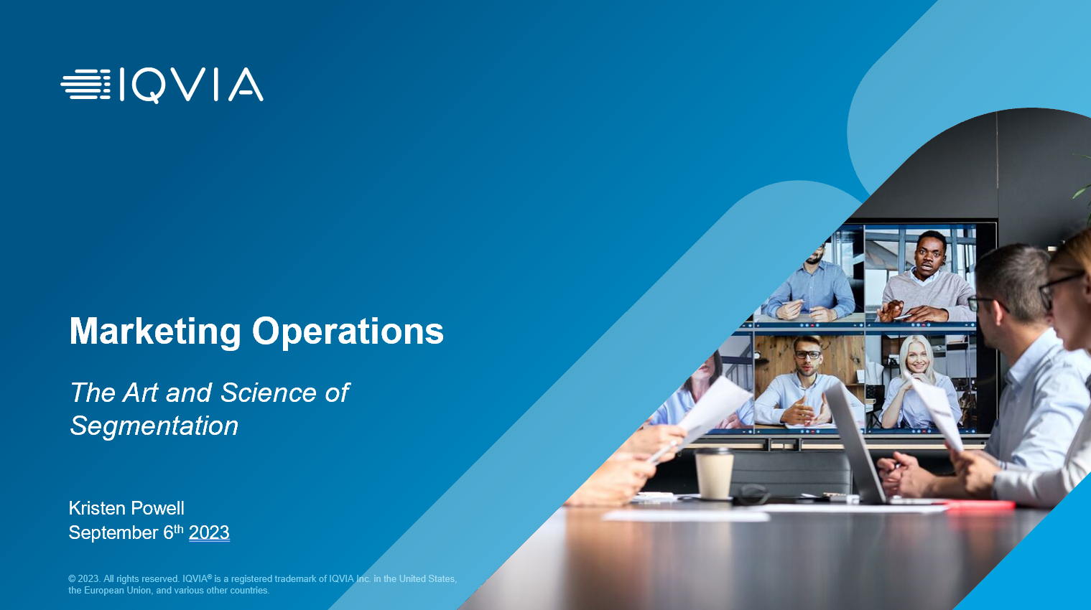
The art and science of segmentation
Importance of segmentation
Organize your way to better email performance, Improved relevance, Guide customers through the funnel
Header
Using customer data to create more targeted and personalized messaging
Entry Point, Geographics, Behavioral, IQVIA Segmentation, Mapped Functional Area, Mapped Job Level
Standard and Master Exclusions
Exclusions applied to all emails
Segment types
Standard segment, Bullseye Segment, Persona Segment
Notes:
Phil Cuff

Slide 13
When do you use UTMs on your URLs?
When you are linking to a third-party site
When you are linking to an ON24 webinar
When you are linking to a pdf
When you are linking to IQVIA.com

Slide 14
When can I expect monthly reporting?
1st of every month
10th of every month
10th business day of the month
11th of every month

Slide 15
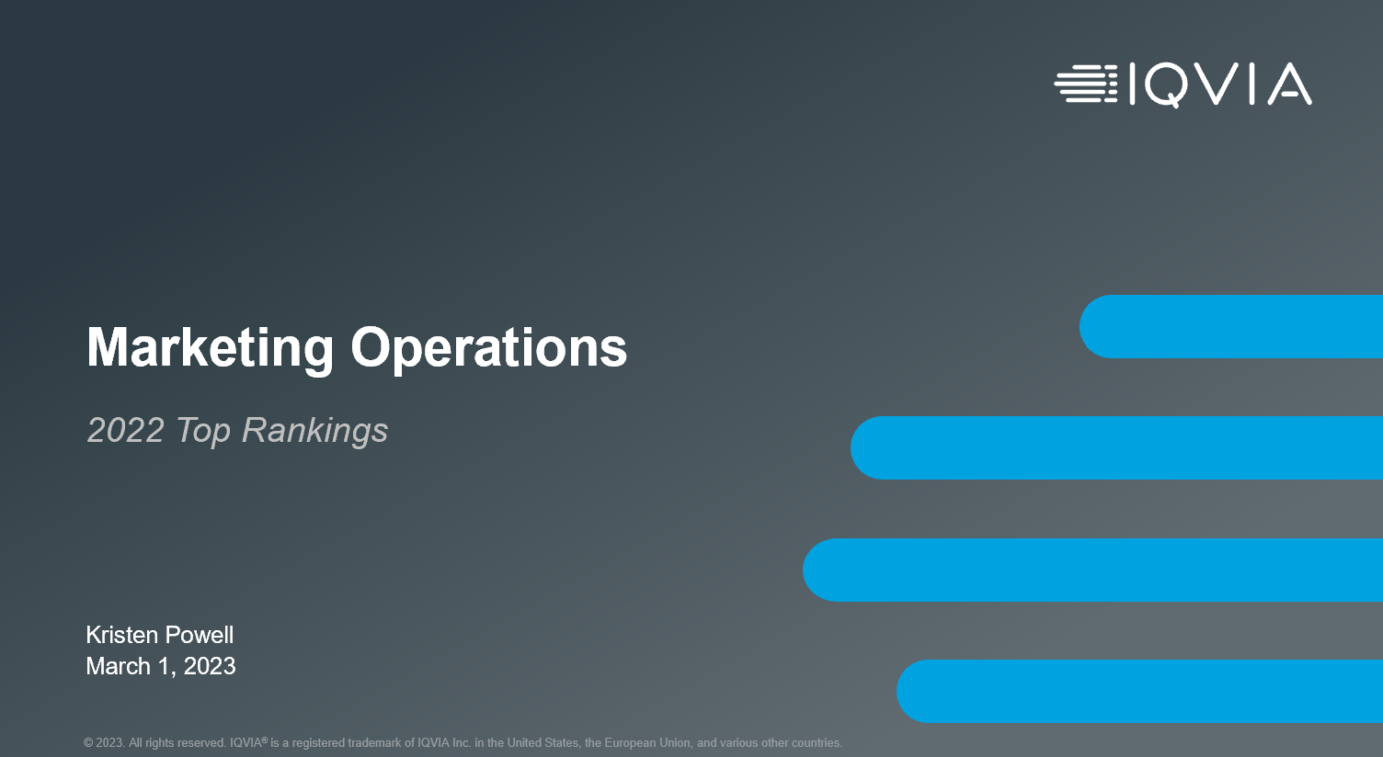
Top Rankings
Top sources bringing in contacts to the database
DnB, SFDC, Acquisitions, Gated forms
Header
Highest MQL acceptance rates
Events, Third Party Provider and Webinar MQLs
Highest conversion rates
Organic Search, Paid Search, Organic Social
Top campaigns + content
NNCs, MQLs, SQLs, SQL Amount

Slide 16
The length of your email subject line should be
Less than 60 characters
As many as you need
60 – 120 characters
121 – 160 characters

Slide 17
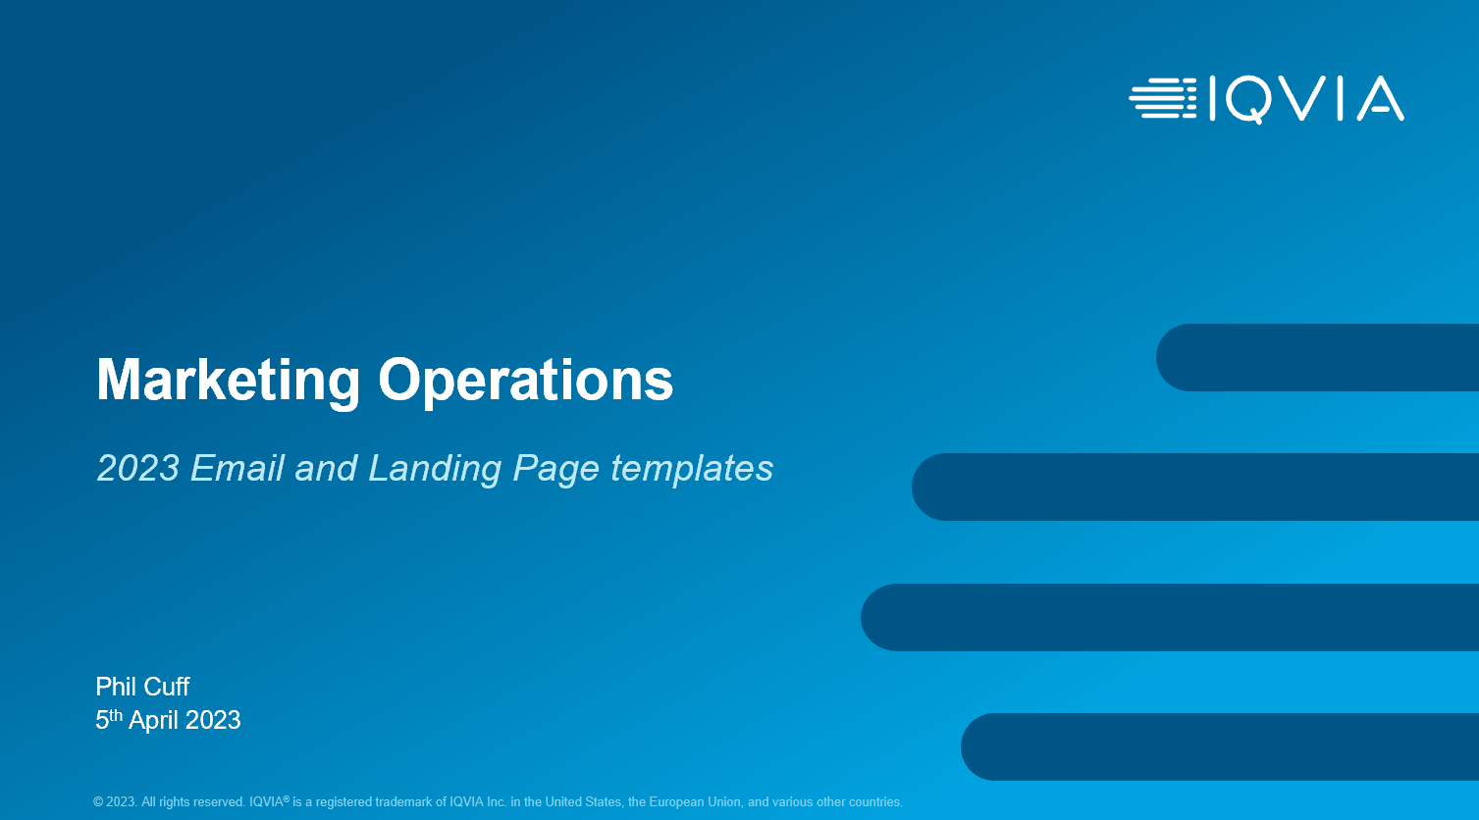
Email and landing page templates
Email and Landing Pages
Updates to Eloqua templates and layouts; Banners and BYO email body images
Header
Sub-brands
Technologies, Medtech, Consumer Health
Toolbox
Where to find the templates; Help section
BYO Tools
Video walkthrough, new BYO studio tools

Slide 18
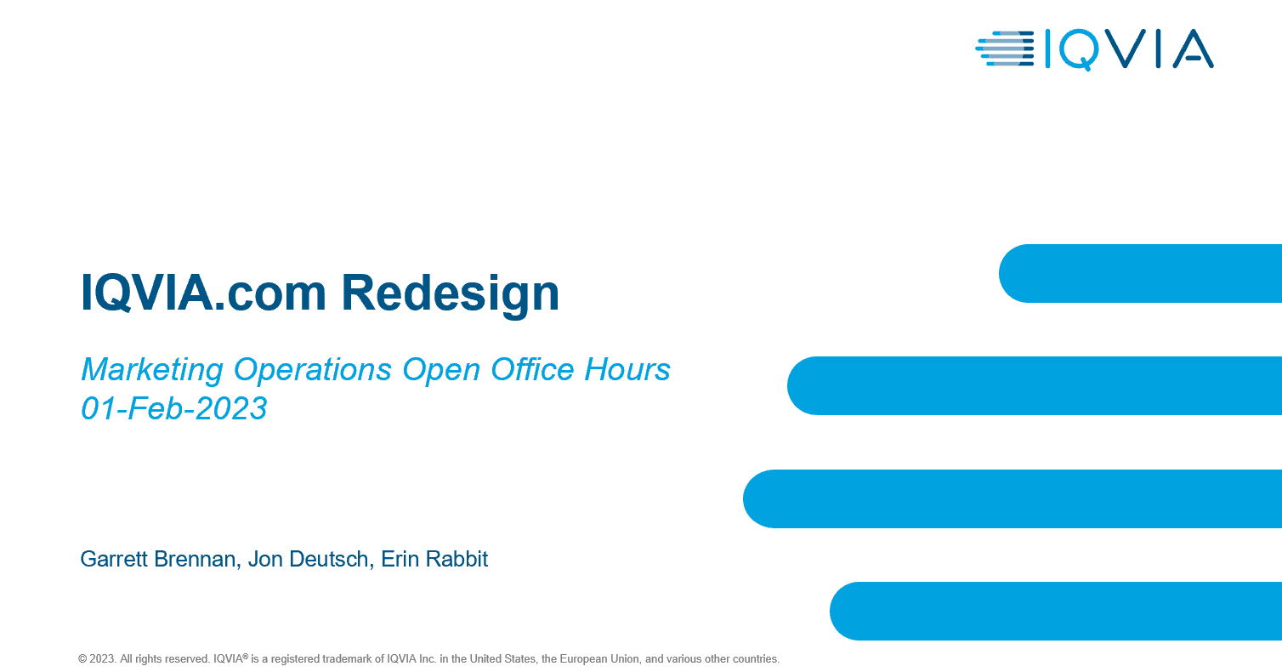
IQVIA.com Redesign
IQVIA.com Redesign
Dec 16, 2022
Header
Highlighting the new features, how to use them and best practices
Webinar/Event, MQL Form Submits, External Activity File Uploads
New templates
Reference and use the new template modules for any new publishing requests
How to continue improving our website experience
Remove outdated content, report problems/bugs, send your ideas
Notes:
Garrett Brennan, Jon Deutsch, Erin Rabbit

Slide 19
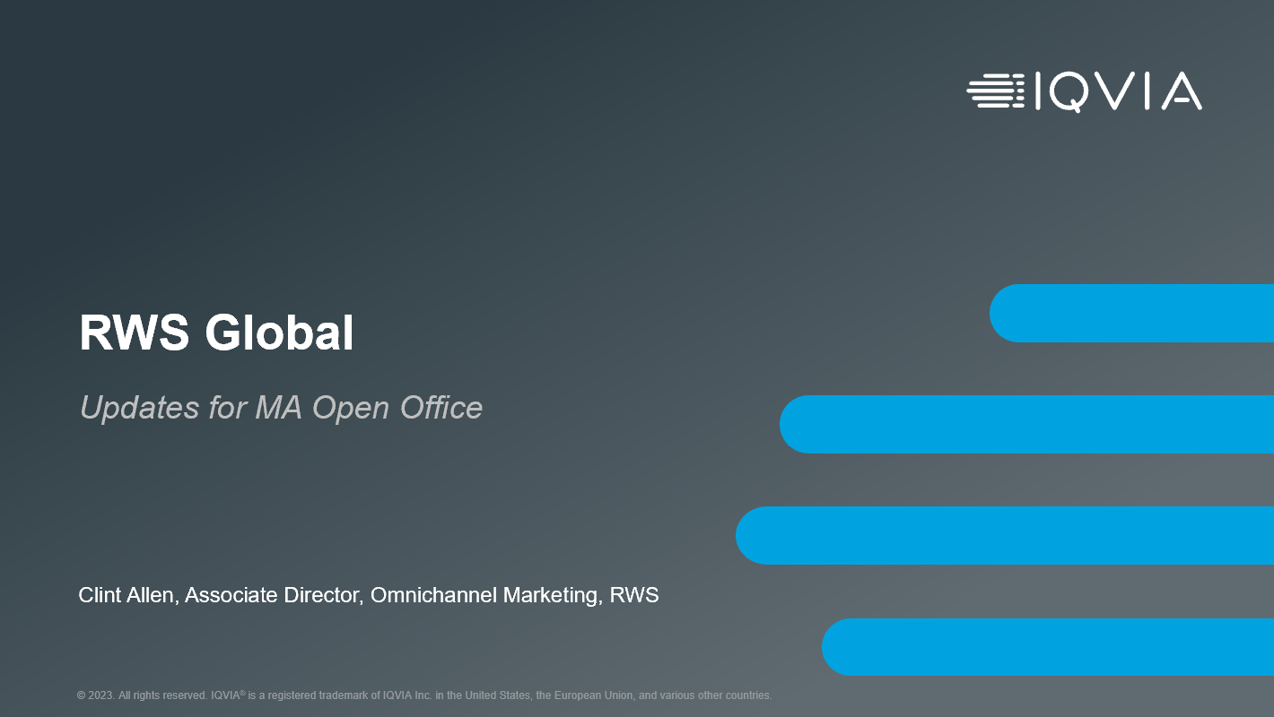
RWS Global
Their top campaign generating 138 MQLs
Q1Nurture email campaign
Header
3 emails
Nurturing conference audiences directing to landing pages
Strategy to increase MQLs in 2023
Focusing Emails on MQL generation, expanding Eloqua efforts, staying in market, integrate with other channels
Hybrid form
Free content and MQL from
Notes:
Clint

Slide 20

SEO best practices
What is SEO
Search Engine Optimization is the process of increasing traffic to a webpage through non-paid search engine results.
Header
Organic vs Paid
Visual results from both
How google ranks websites
Crawling, Indexing and Ranking
Elements of SEO
Internal linking / anchor links, keyword research, backlinks, on page SEO
Notes:
Sathya

Slide 21
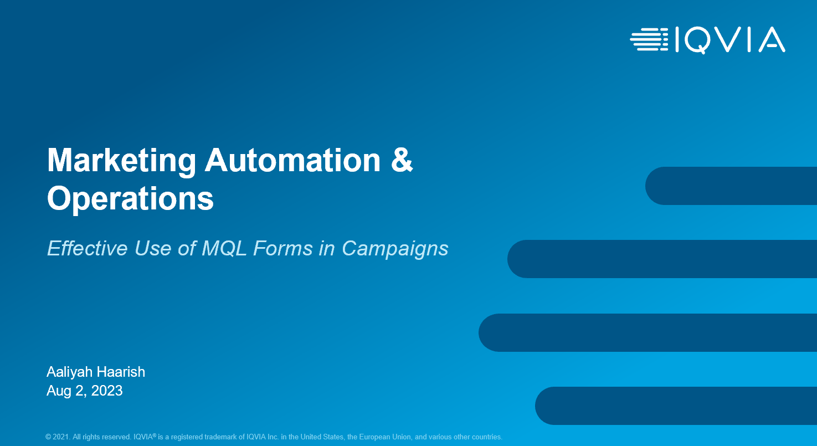
Effective use of MQL forms in campaigns
3 Form Types
Non-MQL, MQL and Hybrid
Header
Required fields
List out all required fields for each form type
Top 3 landing pages driving MQLs
Biotech, US, RWS
Best practices
One objective, target specific audience, short, attention-grabbing titles/headlines, relevant images
Notes:
Aaliyah

Slide 22

Optimizing website requests
Research and strategy
Approved content, unique content, connecting content, keyword research, inspiration, goals
Header
Key elements of a request
Reporting group, tagging, taxonomy and SEO, The file(s)
Resources
Toolbox, Brandworld, SEO best practices
Shout outs
Examples of users submitting optimal requests

Slide 23
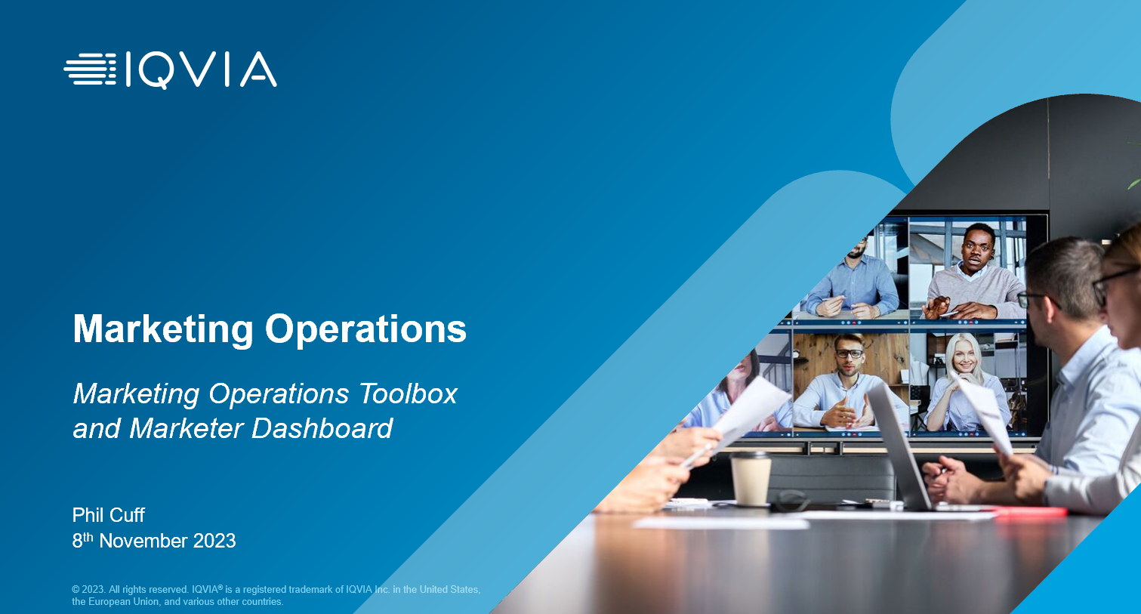
Marketing operations toolbox and marketer dashboard
Strategy of toolbox redesign
For marketers, for marketing ops, for reporting/metrics, LEAN
Header
Operational plan
Reporting Enhancements, Website Request Forms, Paid Social Forms, Organic Social Forms, Site Redesign, LEAN Productivity Updates
Old to New
Walkthrough of the toolbox
Marketer Dashboard
View request details, converse with marketing ops, add attachments, single location
Notes:
Phil Cuff

Slide 24
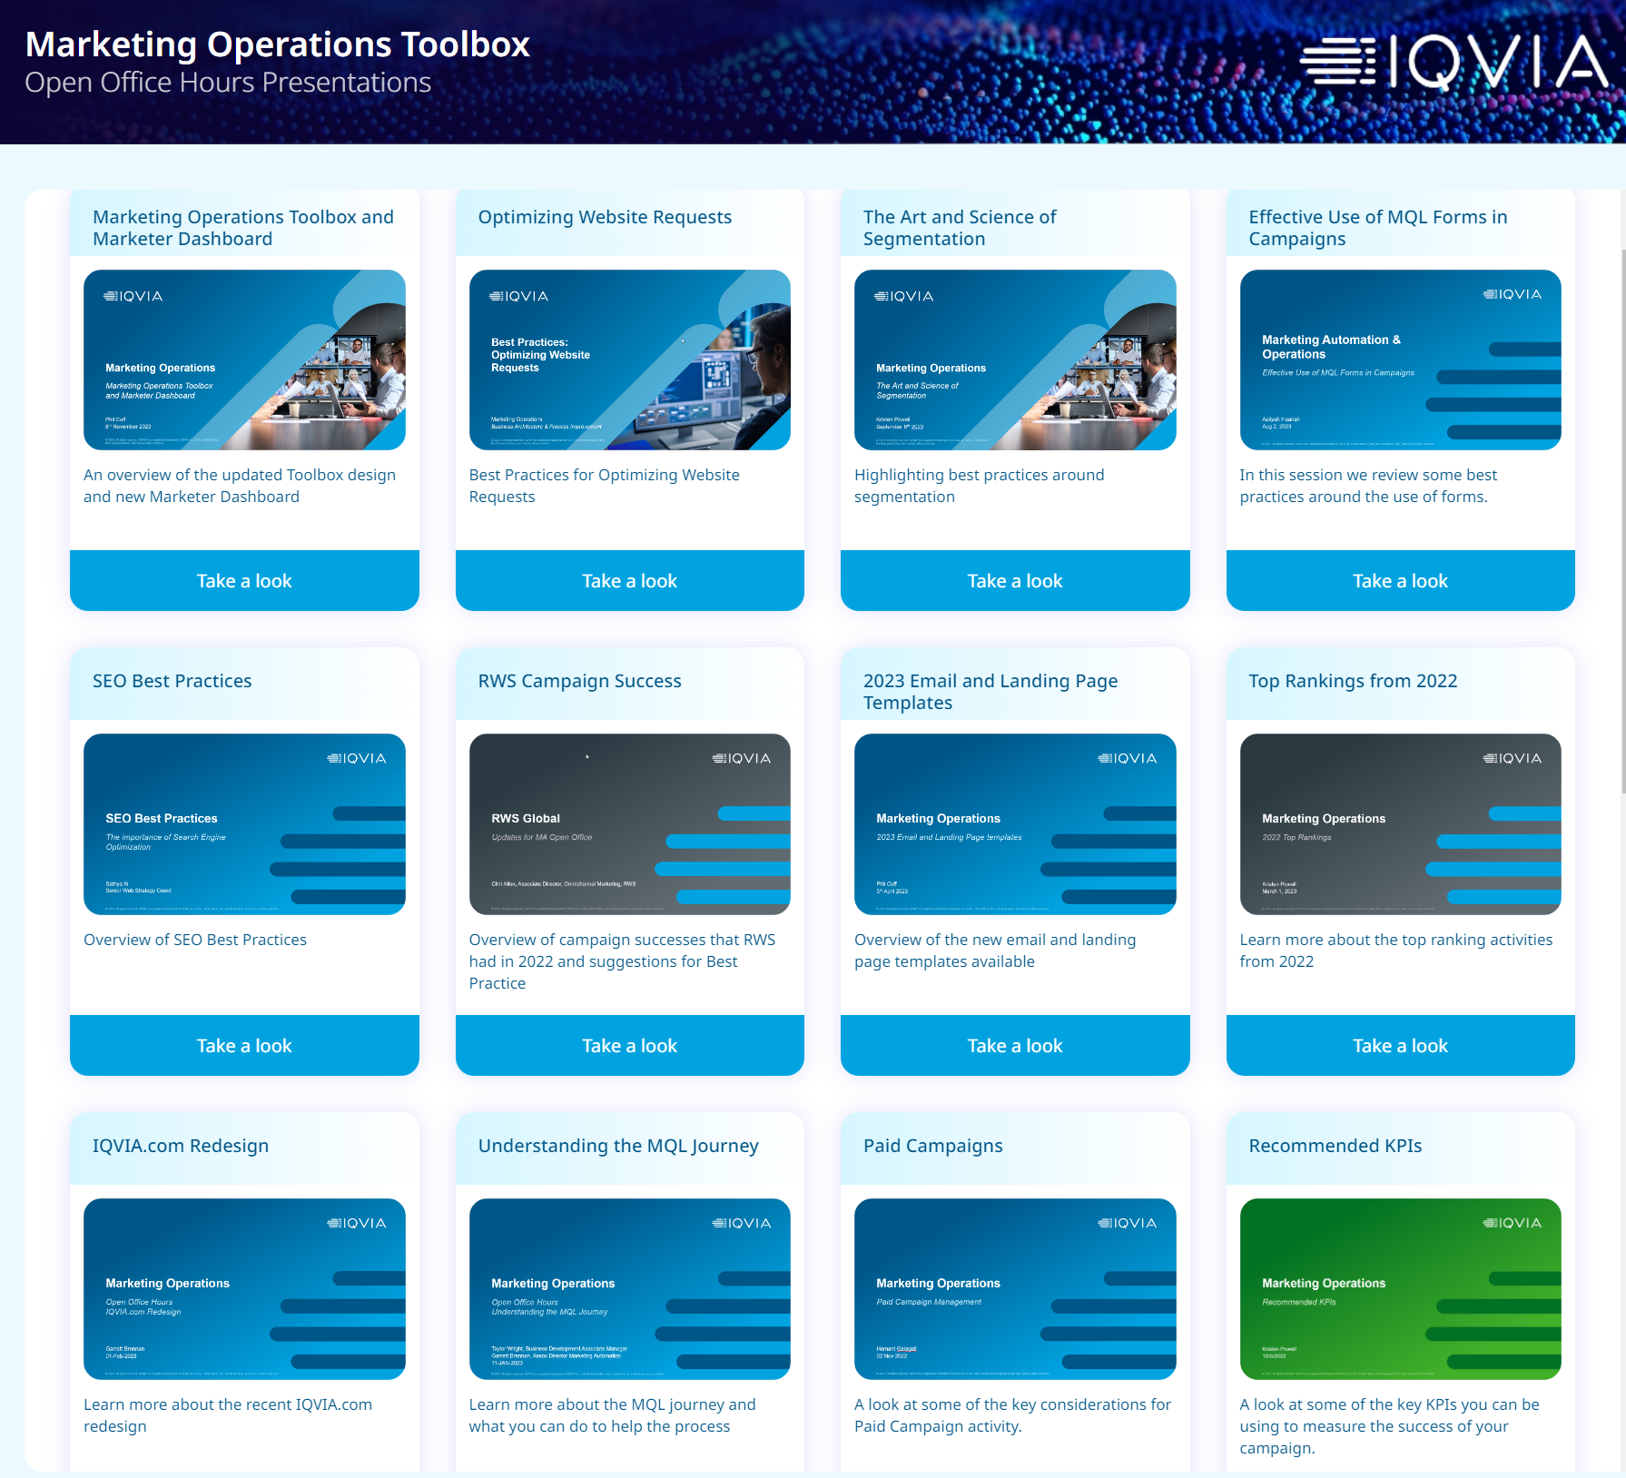
Find details on these topics in the Marketing Operations Toolbox

Slide 25
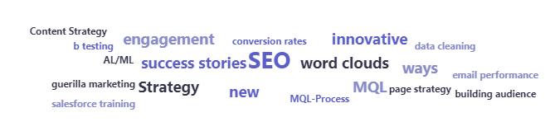
What topics do you want to see more of next year? (word cloud)

Slide 26
Thank You

